Slide 1
Who has hypercapnia and how much should we care?
BRIAN LOCKE PGR
(Title Redacted)
This work is supported by the American Thoracic Society ASPIRE Fellowship and the National Institutes of Health under the Ruth L. Kirschstein National Research Service Award 5T32HL105321
Disclosure: I hold a financial stake and advise a local startup called Mountain Biometrics (focused on data processing of wearable sensor data)
Notes:
TODO: streamline the slides

Slide 2
What makes a problem worth researching?
INT Framework (World Health Organization and other grant-makers)
Importance of the problem:
How many people (will be) affected by the problem, and how intensely?
Neglected-ness
How much effort is already going toward solving the problem? (is it going to be solved anyway? Will a bit more effort help?)
Tractability
Is the problem solvable? (What has prevented others from solving it?)
Hypercapnic Respiratory Failure scores high in all 3
Notes:
INT framework: Importance, Neglectedness, and Tractability.
Importance: how many are effected and how intensely? Available data suggests that any-cause hypercapnia is as common as decompensated cirrhosis. Additionally, research on patients who are identified to have hypercapnic respiratory failure
Neglectedness: how many other individuals are working on this?
How would one estimate the neglectedness of the issue?
-There are few other research gruops focusing on the issue.
-It is only recently that calls to consider chronic respiratory failure as it’s own pathway, in need of shared care processes [ats citation]
You could also argue this population has been neglected because of the role of intractable, and often moralized, medical problems: obesity and opiate use.. and thus they may not generate as much research attention - despite being equally needy.
Tractability: can we make headway?
In the short term - the argument for tractability is that we’ve already generated some simple, proof-of-concept predictive modeling of the presence of chronic hypercapnic respiratory failure that shows performance that is robust to a variety of checks aimed at approximating the impact of partial verification. Furthermore, we have demonstrated that these predictors are based on physiologic principles, and thus are likely causally related - increasing the propensity.
Lastly, we believe this is tractable because

Slide 3
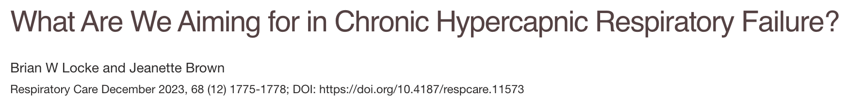
How should we study these patients?
Paradigm | Disease-Based | Syndrome-Based
Pros | The causative disease is usually an effect modifier for treatments → homogenous response better for efficacy trials. Funders often interested in specific diseases | Hypercapnia is often recognized before the cause; outpatient workup, so initial management is empiric. Efficacious management shares features. Enables assessment and improvement of processes of care.
Cons | Difficult to extrapolate results to patients with multiple contributing conditions. Evidence only applies to definitely-evaluated patients | May distract from better understanding the way different cases differ Lumping vs Splitting (e.g. Sepsis, ARDS)

Slide 4

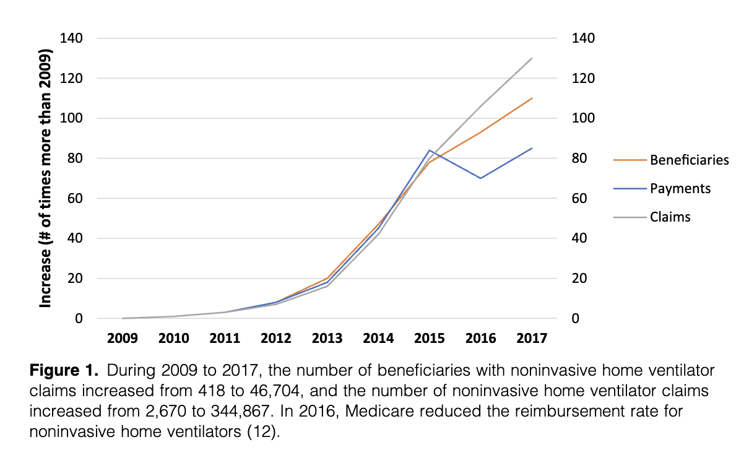
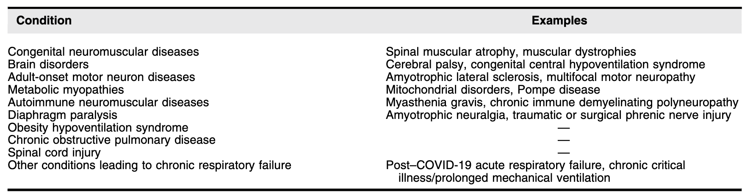
Shared Management
Annals ATS 2024

Slide 5
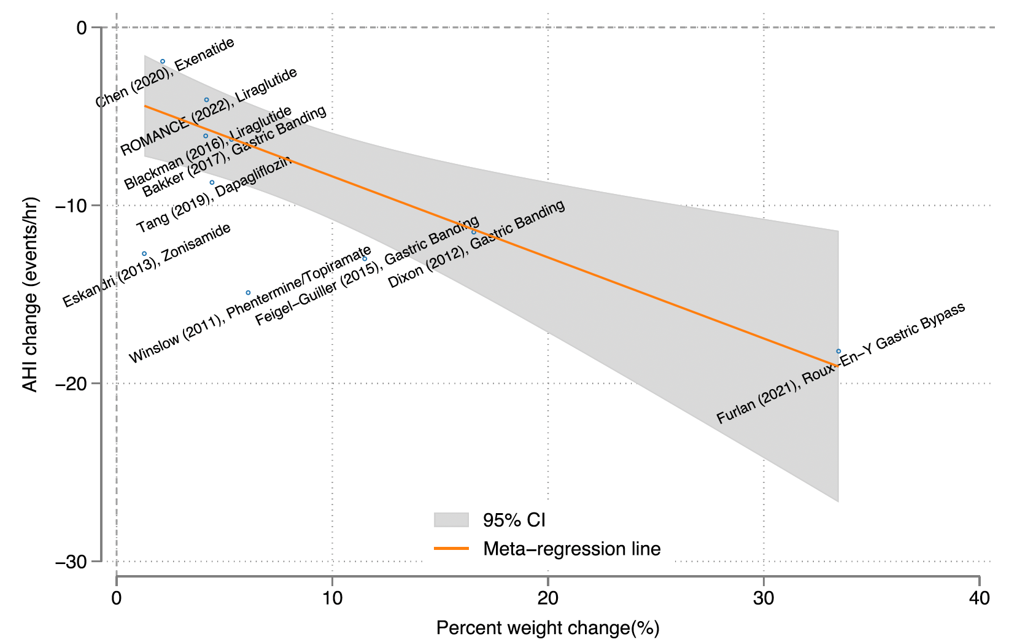
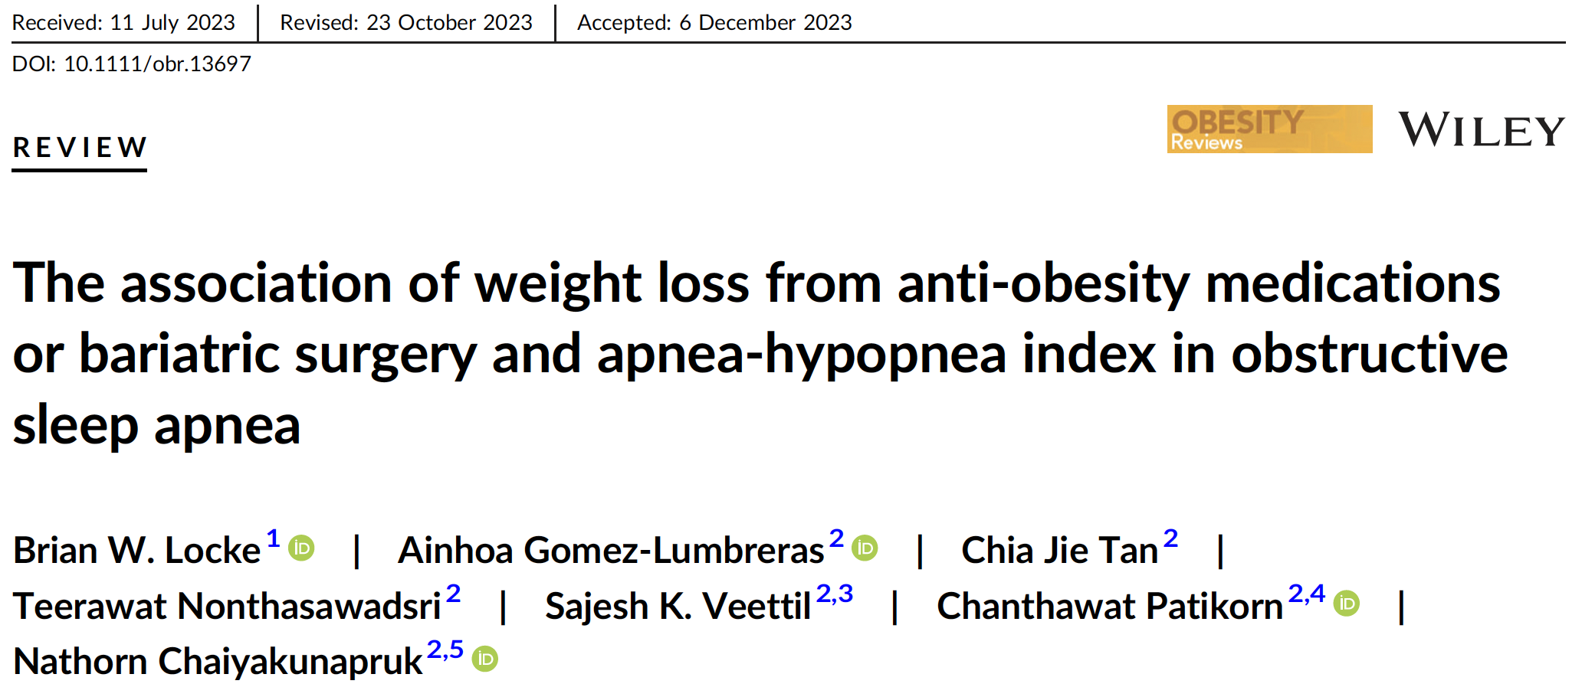
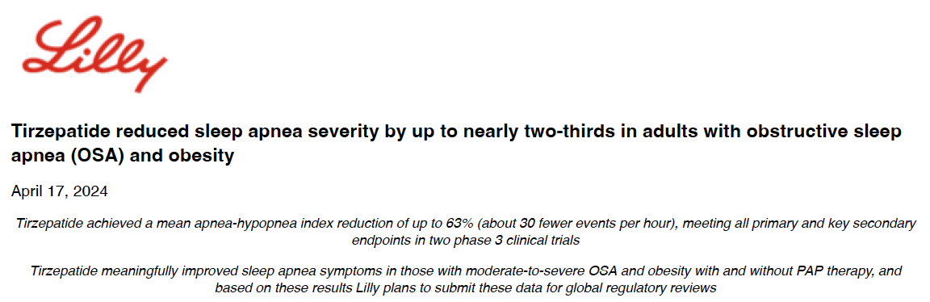
Would GLP-1RA work in patients with obesity and hypercapnia regardless of cause?
10 RCTs (4 surgical; 6 med. n=854)
Study-level meta-regression
1% weight loss → 0.45 less AHI event/hr
How often does obesity or OSA contribute to hypercapnic respiratory failure?
Notes:
study-level weight loss predicts the
mean change in AHI (p = 0.005, Figure 4), with a 1% average weight
loss expected to cause a 0.45 events per hour decrease in AHI (95%
CI: 0.18–0.73 events per hour).

Slide 6
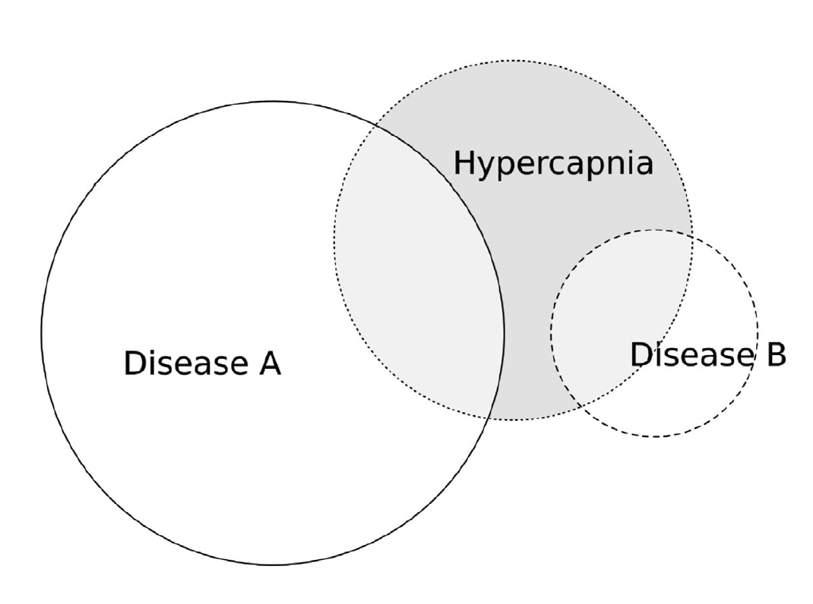
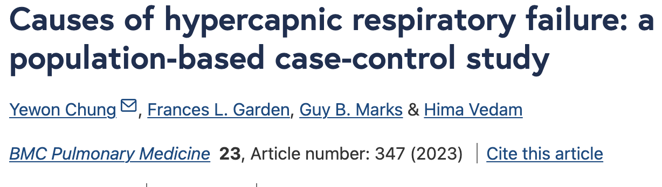
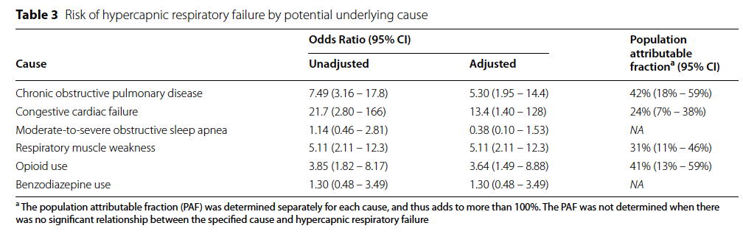
What are the most important (population) causes of Hypercapnia?
1 hospital serves population of Liverpool, AUS.
Random sample of ED cases (PaCO2 ≥ 45 mmHg) and stratified sample of community non-cases.
Assess: Med Use, BNP, Spiro, HSAT, SNIP
Estimate Population Attributable Fraction: cases that would be prevented if factor eliminated.
Fatal problems: 10% got HSAT; causal pathways
(Spiro)
(BNP)
(HSAT)
(SNIP)

Slide 7
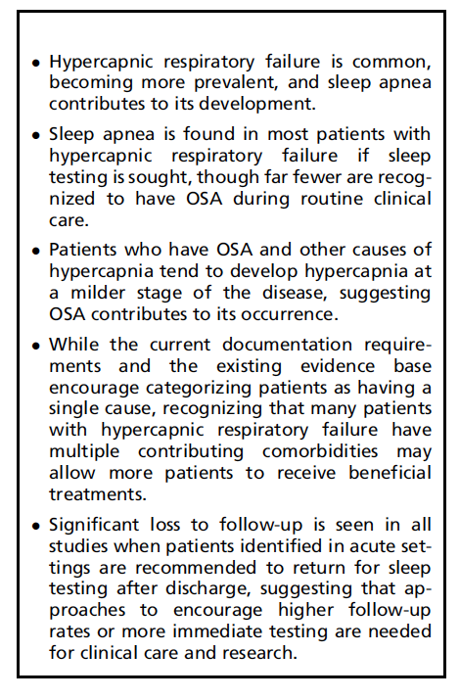
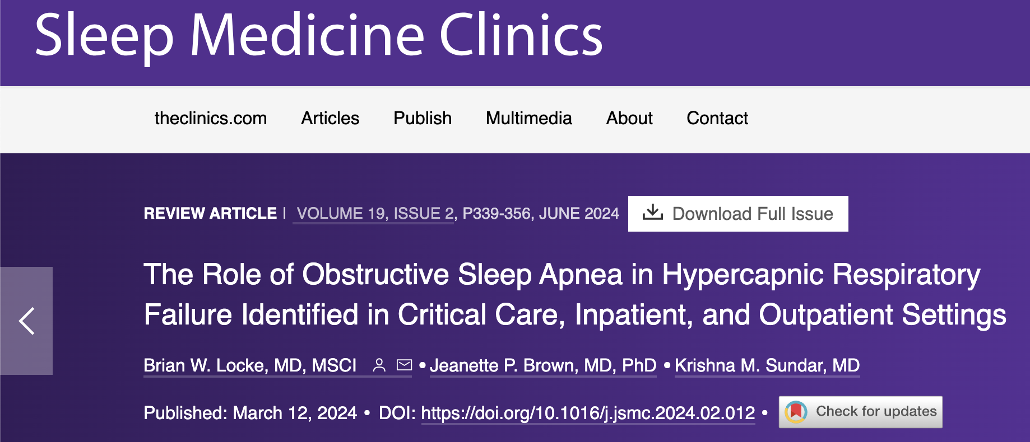
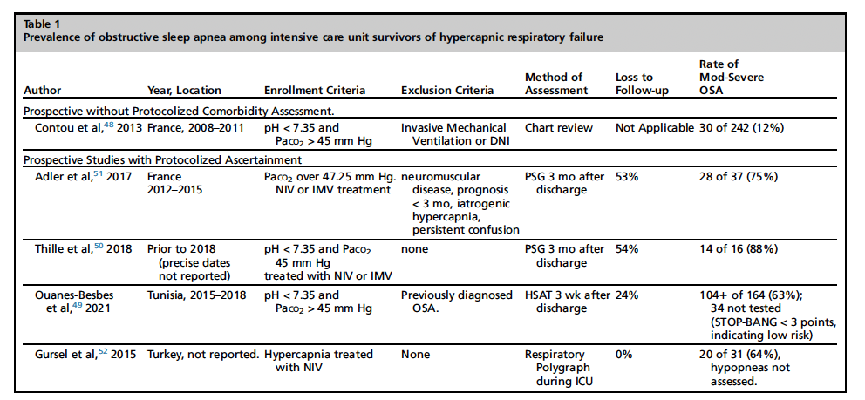
What do we know about sleep?

Slide 8


Analogy to decompensated cirrhosis: is hypercapnia decompensated ventilation?
(more properly, acute/chronic liver failure- as cirrhosis is the pathology, not the syndrome)
Consider: Liver failure requires shared management regardless of disease cause.
Population-standardized prevalence PaCO₂ > 45 mmHg after excluding iatrogenic causes:
150* per 100,000 person/year
*Only inpatients, only those with blood gasses checked
Comparison to decompensated cirrhosis: 94.9 per 100,000 person-year (2017)
Inpatient ICD code for Hypercapnic Respiratory Failure
23% 30-day readmission rate (2 in 3 with recurrence of hypercapnia)
Comparison to decompensated cirrhosis 12.9% in 30d, 21.2% in 90d in 2012

Slide 9
Beware of extrapolation: who counts is tricky
Data Source for several studies:
Encounters: Jan 1 to Dec 31, 2022
TriNetX research network: EHR data from 76 medical centers, roughly 115 million patients
Enriched data set mirroring the spectrum of patients a good provider should consider that hypercapnia might be present
One of: Predisposing condition (incl. BMI > 40), any resp failure, received ventilatory support, received ABG or VBG (regardless of result)
Data quality check: each encounter must have 1 of each data type

Slide 10
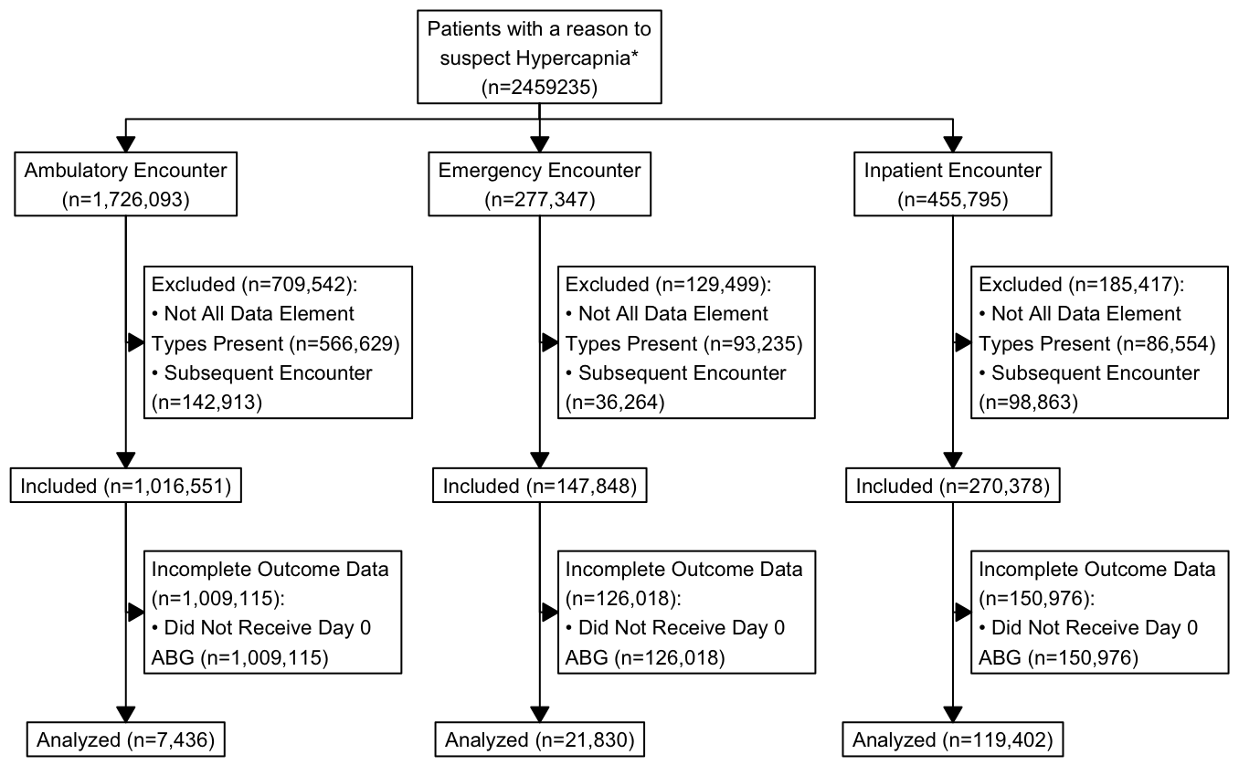
Beware of extrapolation: who counts is tricky

Slide 11
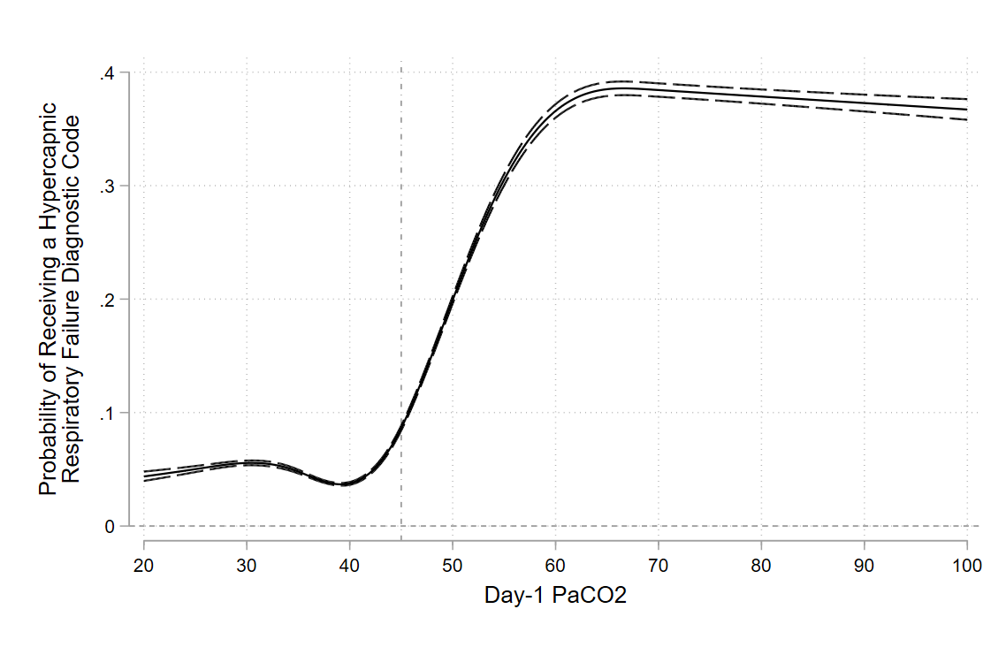
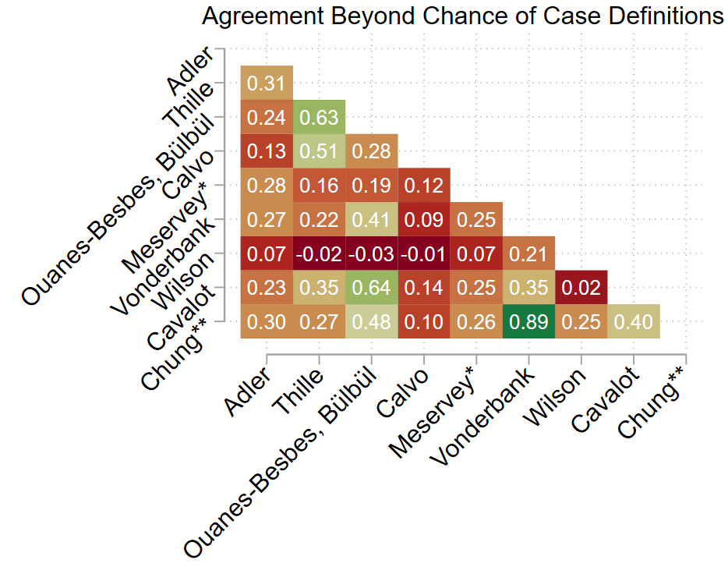
Beware of extrapolation: who counts is tricky
Structured, AI-assisted review identified 14 studies pertaining to the prognosis of any-cause hypercapnic respiratory failure.
Inclusion crit: Variety of ABG, VBG, ICD, & procedure codes used
TriNetX Emulation: Limited overlap, ICD codes very insensitive.

Slide 12
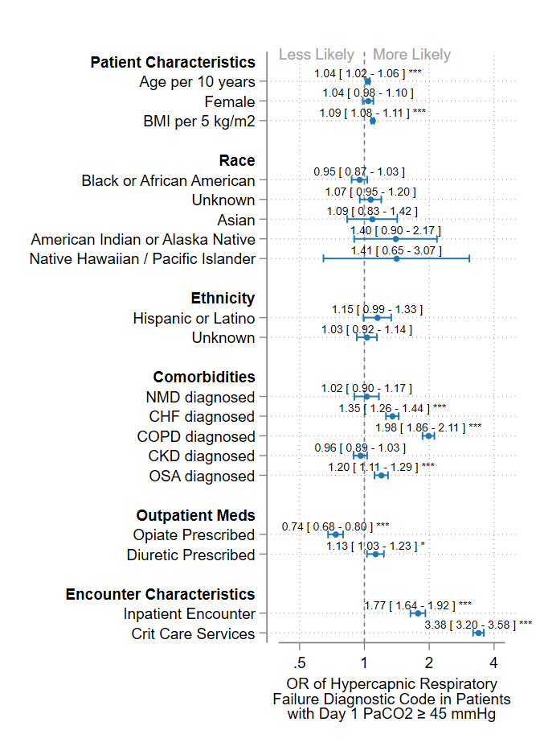
Beware of extrapolation: who counts is tricky
If you have hypercapnia, context influences the likelihood of Hypercap RF Label
Cohorts identified by the various case definitions varied widely. E.g:
16% Black using Wilson to 26% using Calvo
43% receiving a COPD diagnosis code in Meservey to 23% using Adler, Thille, and Cavalot
Case definitions requiring a procedure code for ventilatory assistance → more patients who received critical care services, and died
Crux of the problem: Many patients who have hypercapnia don’t get an ABG. P(ABG) varies.

Slide 13
Epidemiologic Theory
What is the effect of an exposures (E) on an outcomes (O)
Often, a confounder (influences both E and O) distorts the relationship.
If there is an association between E and O, there are 4 explanations:
Chance
Confounding
Bias
Selection
Measurement
A real effect
Argument for cause is the disjunctive syllogism:
“When you have eliminated the impossible, whatever remains, however improbable, must be the truth. ”
If you can’t reliably identify who has hypercapnia, you can’t study its impact on outcomes, control for it in studies of other things, or use it as an outcome.

Slide 14

How often is respiratory depression reported in clinical trials?
Dustin Anderson-Bell & Brian Locke
CHEST 2024 abstract
Severe adverse drug events (SAE): death, hospitalization, prolongation of hospitalization, disability, incapacity, or situations where action is required to prevent one of the preceding events. [no attribution to intervention]
ADEs must be submitted to clinicaltrials.gov.
Shi & Du used BioBERT to extract arm-level data, including SAEs
6,429 trials (summarizing data from 4,863,170 participants) reported outcome & adverse even
Additional 5,300 trials (4,097,827 participants) uploaded at least one adverse event.
Categorized: plausible (e.g. ‘respiratory failure’) or definitive (e.g. ‘hypoventilation’)
3.8% of completed trials, and 2.6% of partially reported trials reported 1+ definitive event.
Mostly NOT medications known to suppress resp. drive: opioids, benzos, gabapentinoids
Notes:
\We utilized data from clinicaltrials.gov (accessed Dec 25th, 2022) as parsed by Shi and Du (Scientific Data; 2024), who trained a transformer natural language processing model (BioBERT) to extract study arm-level trial elements from each trial’s registration page. Based on a manual review of reported adverse effects, trials reporting at least one either plausible (e.g. ‘respiratory failure’) or definitive (e.g. ‘hypoventilation’) event of hypercapnic respiratory failure. Studies were categorized by condition under study and class of medication or intervention.
plausible (e.g. ‘respiratory failure’) or definitive (e.g. ‘hypoventilation’) event of hypercapnic respiratory failure
At least one definite hypercapnic respiratory adverse event was reported in 242 of the 6,429 (3.8%) completed trials and 139 of 5,300 (2.6%) of trials that have not reported outcomes
6,429 trials (summarizing data from 4,863,170 participants) reported both outcome and adverse event data to clinicaltrials.gov, and an additional 5,300 trials (4,097,827 participants) uploaded at least one adverse event. At least one definite hypercapnic respiratory adverse event was reported in 242 of the 6,429 (3.8%) completed trials and 139 of 5,300 (2.6%) of trials that have not reported outcomes.

Slide 15
How can we improve identification? Make better use of the data elements we have
Venous Blood Gas
ABG: PaCO₂ ≥ 45 mmHg calendar day of admit
VBG: VBG PCO₂ ≥ 50 mmHg calendar day of admit
VBG_corr (Farkas): If VBG SO₂ < 90%, then PCO₂ - 0.2 (diff. in A-V O₂ sats)
Association of evidence of hypercapnia with clinical course
Test showing ↑ CO2 | ABG | VBG | VBG Corr
OR of Hypercapnic RF ICD | 6.5 | 5.6 | 6.1
Absolute Increase (%) | 10.3% | 9.8% | 10.2%
OR of subsequent events during hospitalization
Steroid | 1.51* | 1.13 | 1.2
Crit Care | 1.83 | 1.74 | 1.86
NIV or IMV | 2.6 | 2.02 | 2.29
How much are VBGs currently used?
Patients with an ICD for Hypercap. RF
Admit Day: | No VBG | Had VBG
No ABG | 16.6% | 13.2%
Had ABG | 39.9% | 30.3%
Notes:
Still needs mortality, stratification by location of BG (Emerg vs Inp. vs ICU).
Limitation: Chronic Prognosis, Outcomes only In-Hosp Poor Time Resolution on BG vs Events.
Finish up the inverse propensity weighting.

Slide 16
How can we improve identification? Make better use of the data elements we have
Paired Serum HCO₃⁻ (BMP) and PaCO₂ (ABG) measurements
Optimal HCO₃⁻ Threshold (Youden Index)
Ambulatory | ≥ 27 mEq/L | Se: 60.06%; Sp: 83.55%
Emergency | ≥ 26 mEq/L | Se: 59.19%; Sp: 75.37%
Inpatient | ≥ 26 mEq/L | Se: 54.44% Sp: 80.97%
Critical Care | ≥ 25 mEq/L | Se: 57.07% Sp: 76.30%

Slide 17
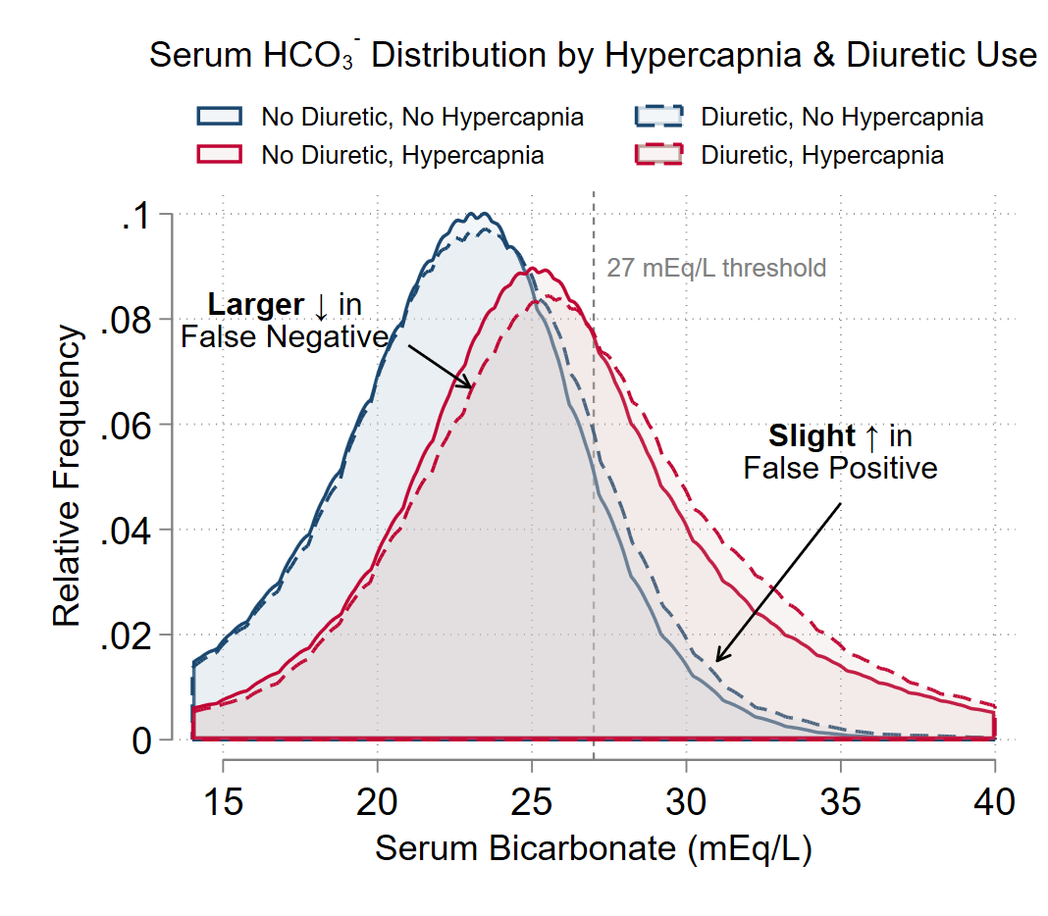

Slide 18
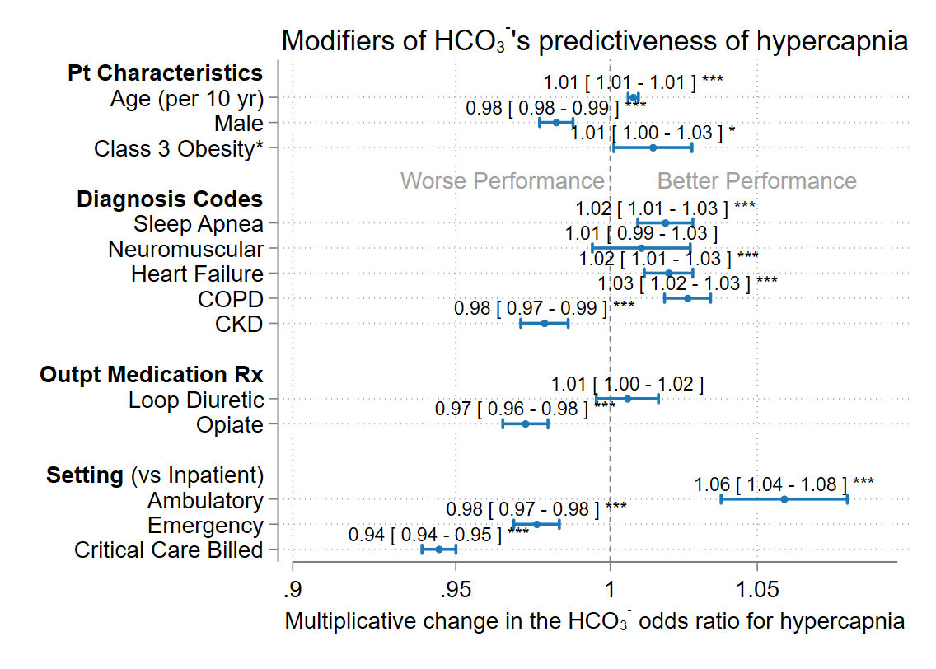

Slide 19
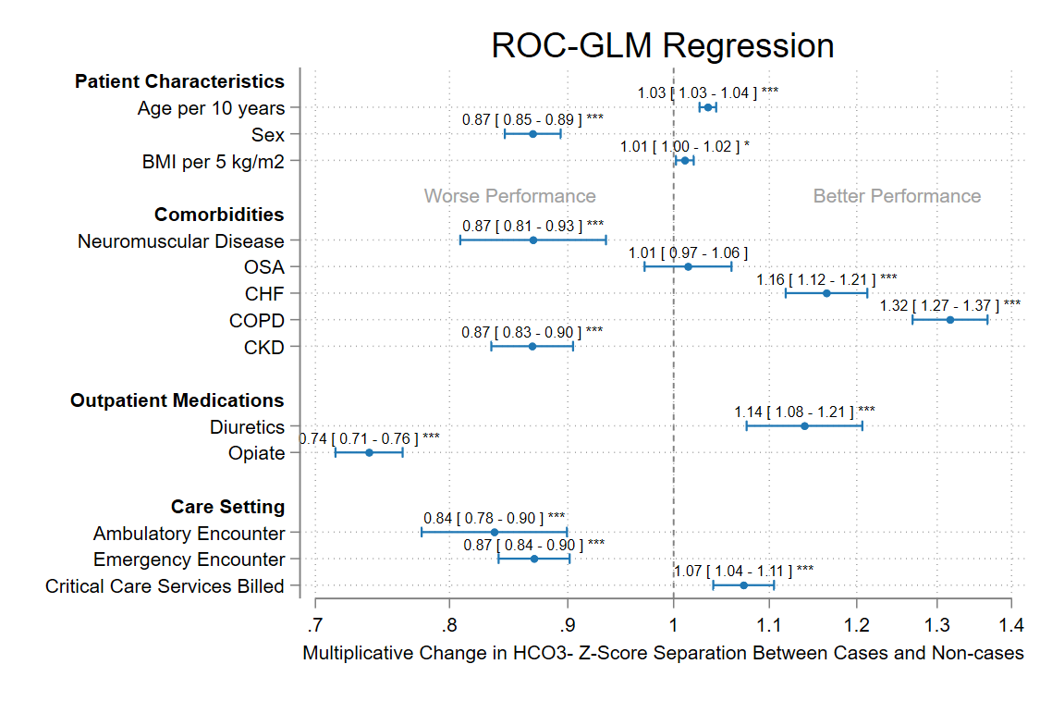

Slide 20
A list of important answered questions in Hypercapnic Respiratory Failure
What are the reasons providers do or don’t order blood gasses?
What are the most common causes of hypercapnia?
What proportion of patients identified as inpatients are referred for and receive definitive evaluation (e.g. PFTs, Sleep Study, Echo)?
What proportion of inpatients with hypercapnia are recognized?
What happens to the patients who are not recognized?
Is hypercapnia a predictive or causal agent of harm?
Are VBGs a sufficient surrogate for ABGs?
Should we be aggressively identifying hypercapnia (or will this lead to overdiagnosis)?
What are the burdens of disease associated with any-cause hypercapnic respiratory failure?
How should we manage multifactorial hypercapnic respiratory failure?
… etc … etc … etc ..
Scoping the research is challenging. Where to start?

Slide 21
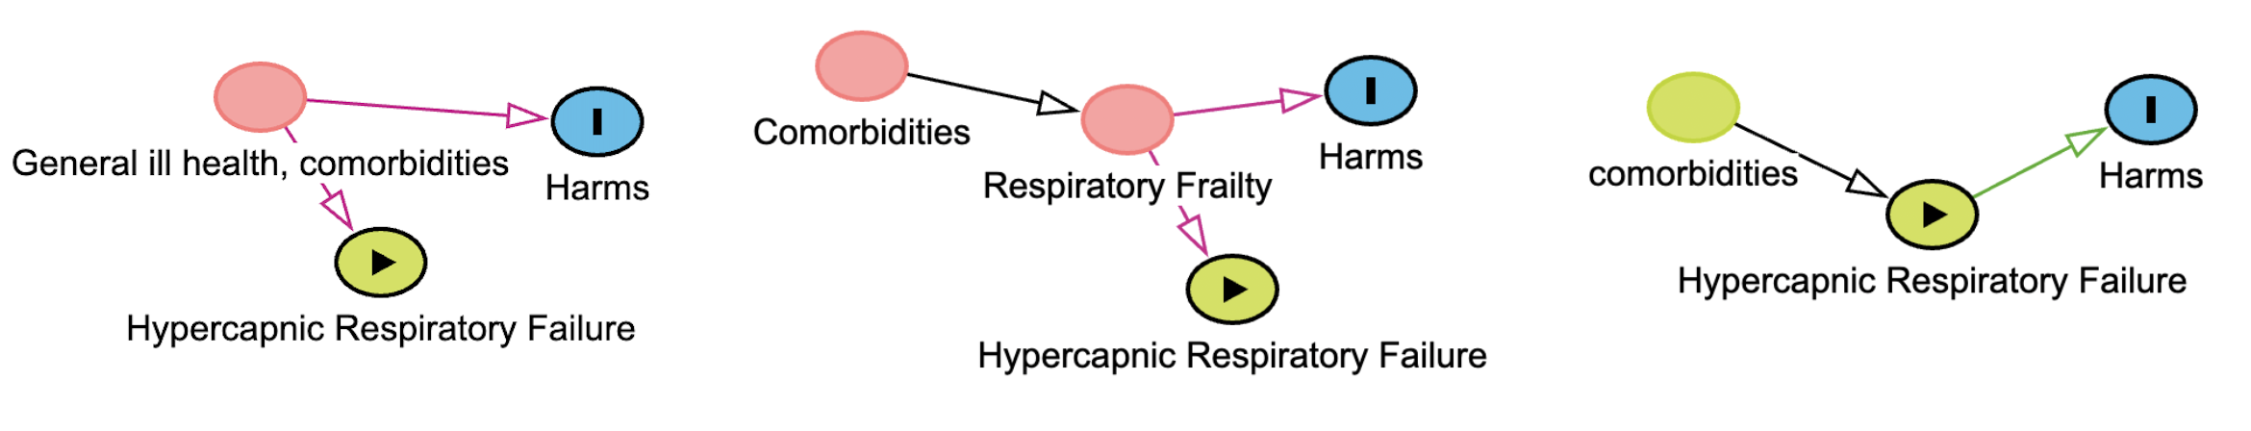
K23: Bioinformatics Tools to Quantify the Disease Burden Associated with Hypercapnia
Gaps:
Identification of hypercapnia appears to be idiosyncratic, which is a problem for patient care and science.
Admissions with hypercapnia are associated with substantial health burdens, but estimates are from single-centers, rely on local identification approaches, and may not extrapolate.
It is unclear if the occurrence of hypercapnic respiratory failure is a general marker of illness, a specific marker of respiratory frailty, or a causal agent of harm.

Slide 22
K23: Bioinformatics Tools to Quantify the Disease Burden Associated with Hypercapnia
My goal is to be an expert in chronic respiratory failure that uses clinical research informatics to enable embedded clinical studies of this population
Career Development Objectives:
Build experience characterizing care processes and variation
Informatics deployment: Gain expertise and experience deploying informatics tools (LLMs and Risk Models) for use in clinical research
Learn Clinical investigation: Learn to lead prospective studies
Notes:
There are so many clinical questions that need to be answered in chronic respiratory failure (and medicine in general) – that business as usual isn’t going to get us there. We need to be able to run studies – ideally randomized trials, but not always – more efficiently and get more information out of the ones we do run.
Evidence synthesis?

Slide 23
Aim 1: Characterize Current Diagnosis and Workup of Hypercapnic Respiratory Failure
Problem: Many patients are identified as inpatients at decompensation but need outpatient workup and management. There is ~no guidance.
Gap: There is no modern estimates of how well we diagnose or evaluate patients presenting with hypercapnic respiratory failure
Hypotheses:
There is substantial variation by institution, provider (training), and patient factor in who receives ABG, VBG, diagnosis, and workup
Most patients are identified as having hypercapnia do not receive definitive workup (PFTs, PSG, pulmonary referral)
Notes:
“Variability, in itself, is not bad but may be an indicator that some physicians are not maintaining an adequate standard of care”
—> or, that a consistent standard of care is clearly established

Slide 24
Aim 1: Characterize Current Diagnosis and Workup of Hypercapnic Respiratory Failure
Solution:
Linkage of Intermountain Health medical records and UT All Payor Claims Database, which contains information on follow-up
Includes (outpatient) testing, referrals, readmissions, deaths
All patients with hypercapnia identified by VBG, ABG, ICD code, and risk modeling (experimental aim: augmented with NLP)
Multi-level logistic regression modeling to characterize factors influencing test ordering
Summary of referral for testing, receipt of testing, readmission, death.

Slide 25

Aim 2: Augment and Locally Validate Hypercapnia Diagnostic Modeling
Problem: Methods of identifying hypercapnia are haphazardly applied, inconsistent, and not patient-centered.
Gap: Reliable, routine methods for identification of hypercapnia are needed.
Hypothesis: The likelihood a patient has hypercapnia can be estimated from routinely obtained data elements, like labs and notes.

Slide 26
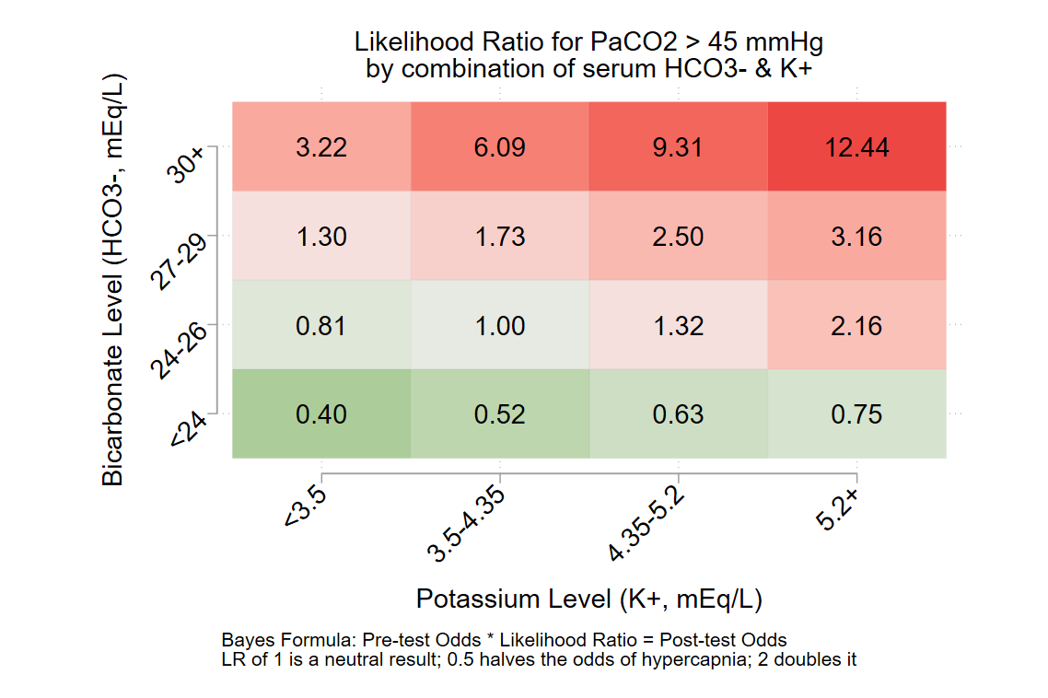
Diagnostic Risk Modeling
Solution: Diagnostic Modeling (Diagnostic Risk Modeling ~= Clinical Decision Rule ~= Prediction Modeling, Diagnostic nomogram)
Wells score is a logistic regression

Slide 27
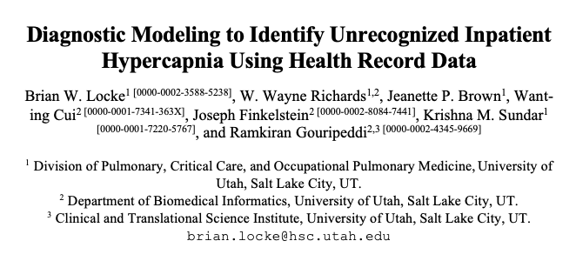
Diagnostic Risk Modeling
Estimate the likelihood of hypercapnia at admission in inpatients.
Predictors: must be routinely available, obtained before/independently of blood gas
2 approaches: LASSO Logistic Regression; Random Forest
Assess distribution of predictions, discrimination, calibration
Partial verification: vs any blood gas (ABG > 45, VBG > 50); inverse propensity weighted ABG
Predictors: age, sex, body mass index [BMI], components of basic blood chemistry testing [sodium, potassium, chloride, bicarbonate, urea, and creatinine], and hemoglobin. Selected a priori on clinical relevance and availability.

Slide 28
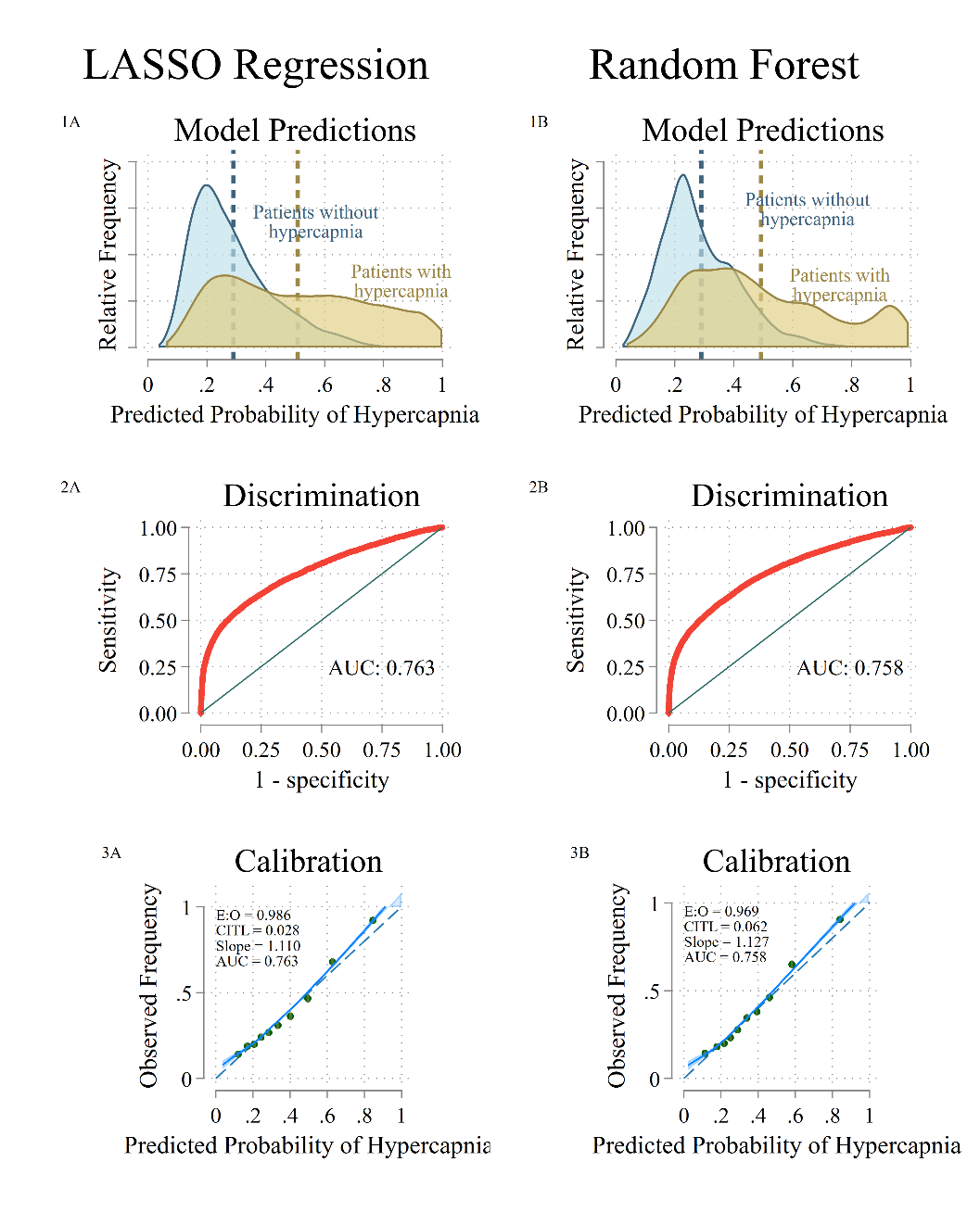
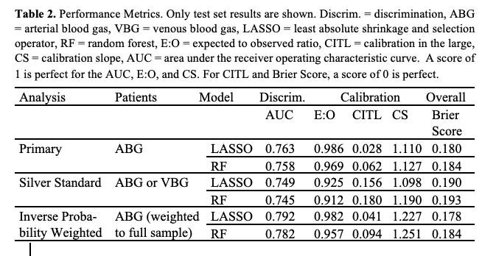
Partial Verification: you can only train on data with outcomes available.

Slide 29
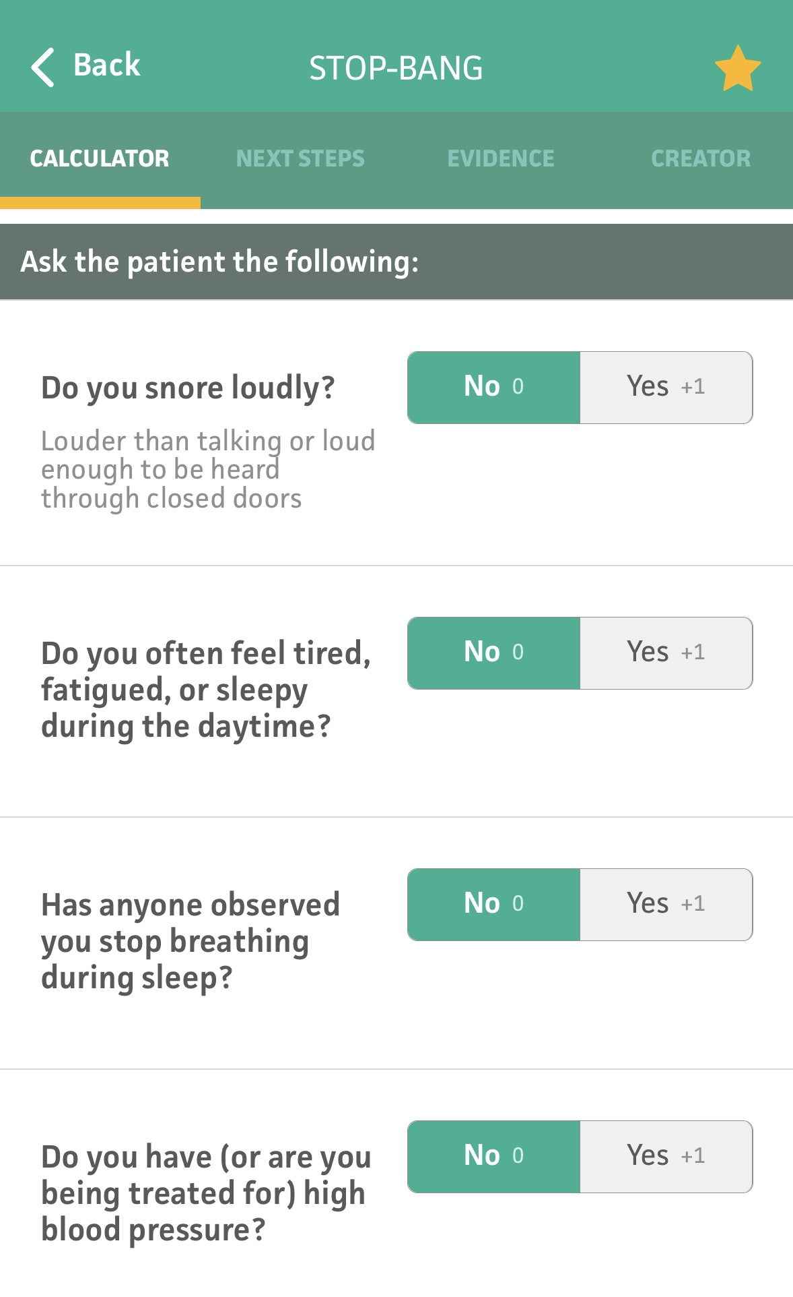
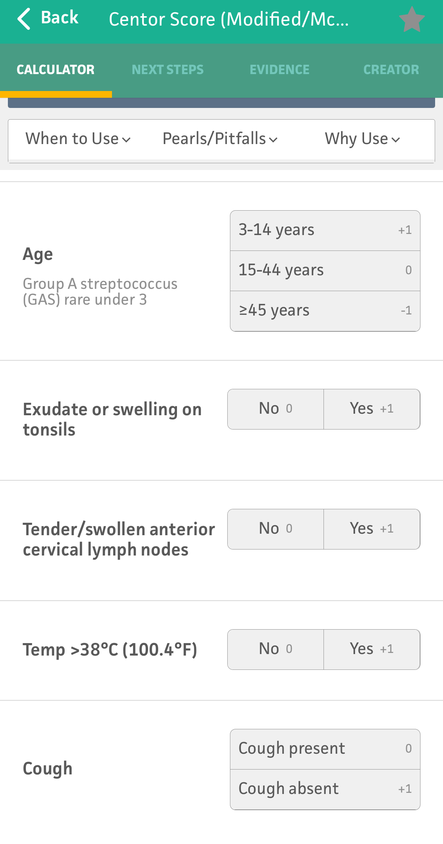
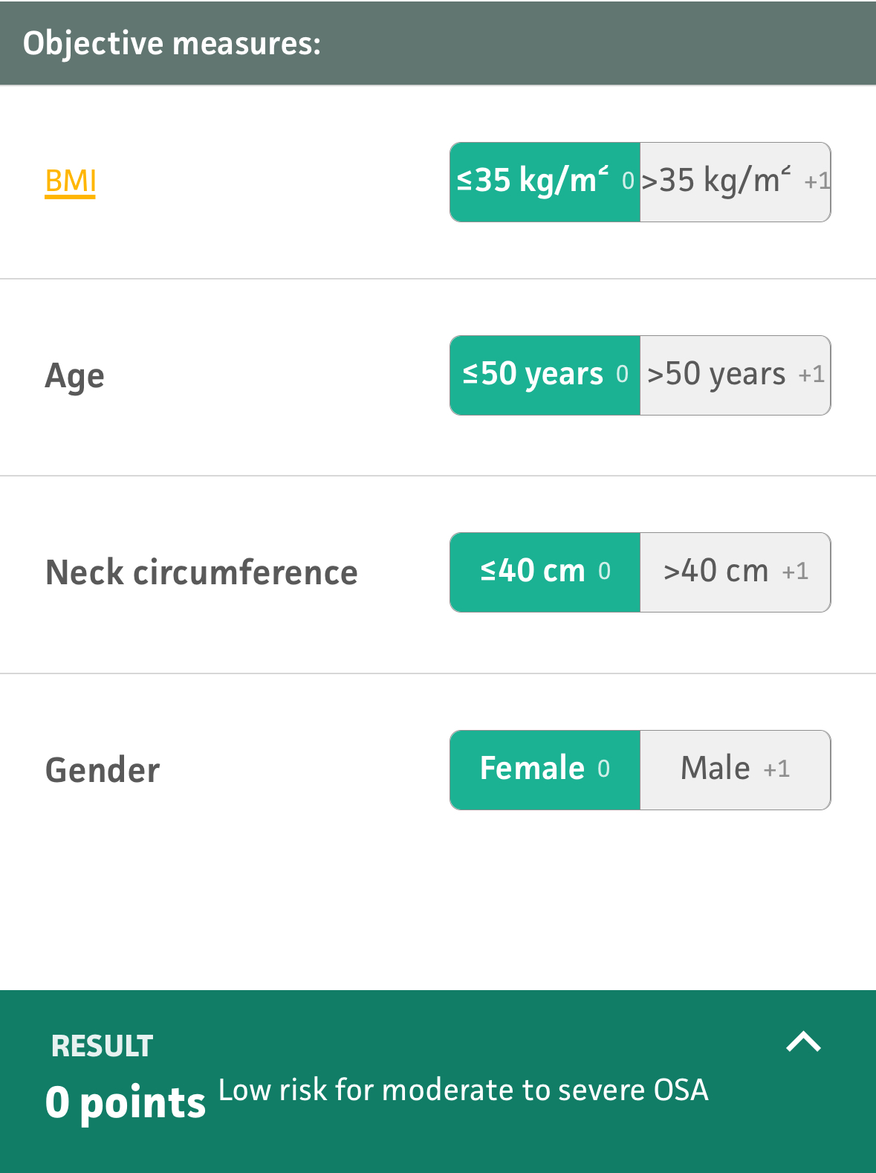
Aim 2: Augment
Problem: model accuracy is imperfect
Gap: Symptoms, which greatly improve prediction accuracy, are in notes.
Hypothesis: extracting this data using locally-deployed LLMs will improve the accuracy of predictions about the risk of hypercapnia

Slide 30


Aim 2: Augment Model
Solution: Large language models enable transfer learning (more on this next week).
1. Extract: Chief concern, confusion, dyspnea, etc. from nursing triage note.
2. Use as predictor in existing model
3. Assess vs limited annotated corpus, but mainly for impact on model.

Slide 31
Aim 2: Validate Model
Problem: We’re interested in people who haven’t received blood gas verification. How well will it work in practice?
Gap: Research consent for ABGs will be biased (and patients with hypercapnia are confused)
Hypothesis: Risk prediction modeling can identify a group of patients highly likely to have hypercapnia.

Slide 32
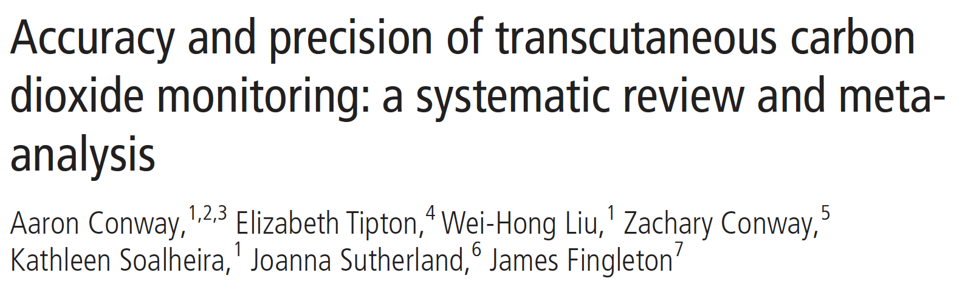
Is TcCO₂ usable for hypercapnia ascertainment?
Conway et al.: 7021 paired measurements taken from 2817 participants in 73 studies
mean bias: 0.085 mmHg
within study SD(agreement): 3.51 mmHg
In-silico simulation of paired TcCO₂ measurement for each PaCO₂ obtained in 2022 via TriNetX.
Sensitivity | Specificity | Neg. Pred. Val. | Pos. Pred. Val
86.8% | 93.7% | 85.7% | 94.2%
Notes:
Note: this is a pessimistic estimate as it includes all studies (variable quality, other devices suboptimal equipment placement)

Slide 33
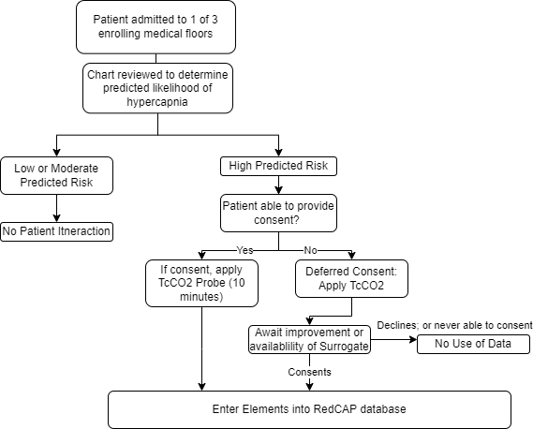
Aim 2: Validate Model
Solution: Validate model predictions using TcCO₂ on newly admitted adults to IMED medical floors.
Protocol:
Admit to medicine – apply TcCO2 within 24 hours to patients with predicted high likelihood of hypercapnia
N=63 patients for power to approximate PaCO₂ +/- 12.5 mmHg in patients predicted 50+% likely.
Deferred (vs waived) consent

Slide 34
Outcomes of this work:
Three novel contributions:
Estimate current use (and variation) of diagnostic surrogates like venous blood gas in a large integrated health system.
Improve estimates of the prognostic significance of any-cause hypercapnia
Establish ABG & VBG independent methods of enrollment
Potential weaknesses: reliance on diagnostic modeling and transcutaneous CO2 sensors. Broad Scope
Strengths: extensive preliminary modeling, contingency plans,
Development of an informaticist-investigator with technical expertise in rapidly progressing subfield of data-science tools, such as LLMs.

Slide 35
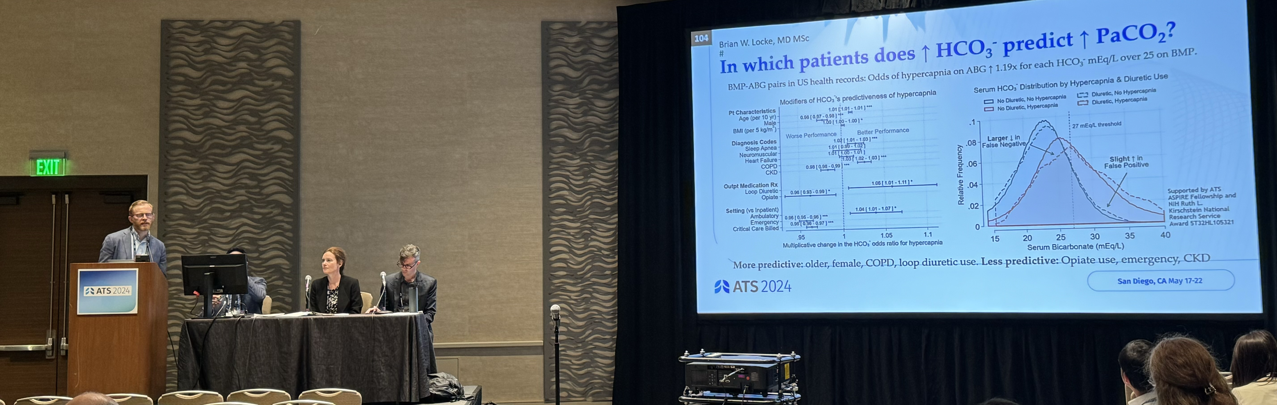
Acknowledgements:
UU PCCM Collaborators: Krishna Sundar, Jeanette Brown
UU PCCM Advisors: Rob Paine, Barb Jones
UU DBMI Collaborators: Ram Gouripeddi, Wayne Richards
IMED PCCM Advisors/Collaborators: Ithan Peltan, Sam Brown, ACR Research Group

